Slide 1
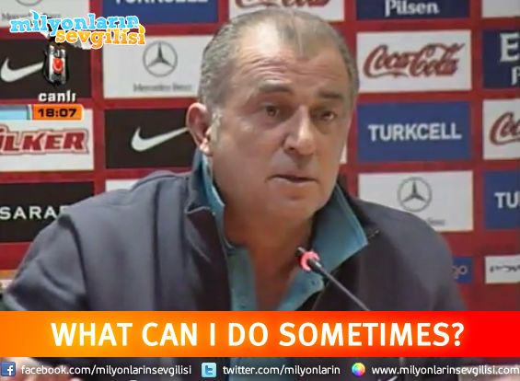
I have a project in my mind
How can I do?

Slide 2
What Need I do?
You should research in google. So market research.
You should put your project on paper.
Show a few people from your friends, family, environment to your project
Is it done? Of course No. Let’s go on!
Let’s skip to next presentation.

Slide 3
More
You should know what need of people.
Most important! You shouldn’t forget to dream.

Slide 4
How will I do?
First of all, you should never focus on doing the perfect job.
You should create prototype of your project.
That means, First; You should design to your project and build all scenarios. In that case, you will see to all field of your project. Include this part: design, database diagram, code, management

Slide 5
The project is alive. What about now?
This is difficult part but you should never give up!
You have to check visitor the project. For this, You can use the Google Services.
You have to reply feedback. Because user comments at project important very much for we.

Slide 6
What about Money?
Perhaps, everybody is thinking about it. Because everybody want earn money. Yes, yes. You are right.
For it:
You can create a income model.

Slide 7
Income Model
Paid membership
Advertising
Paid features
Affiliate
and so on

Slide 8
Come On! Ask me question

Slide 9
Thanks…
Don’t forget follow us on kommunity. ( kommunity.com/devs11 )
And ME :P
github.com/berat
twitter.com/beratbozkurt0
instagram.com/beratbozkurt0

